Slide 1
DT Portfolio
Kahngjoon Koh

Slide 2
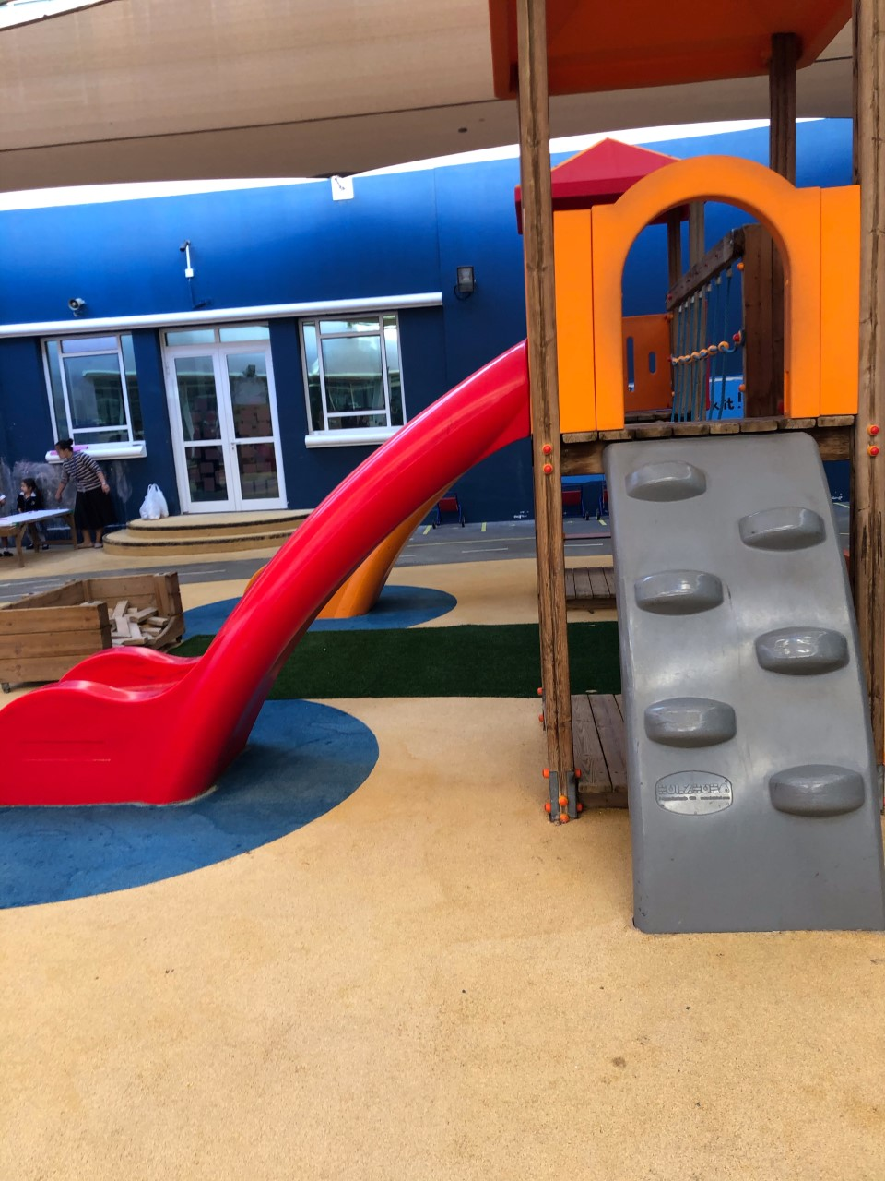
Playground

Slide 3
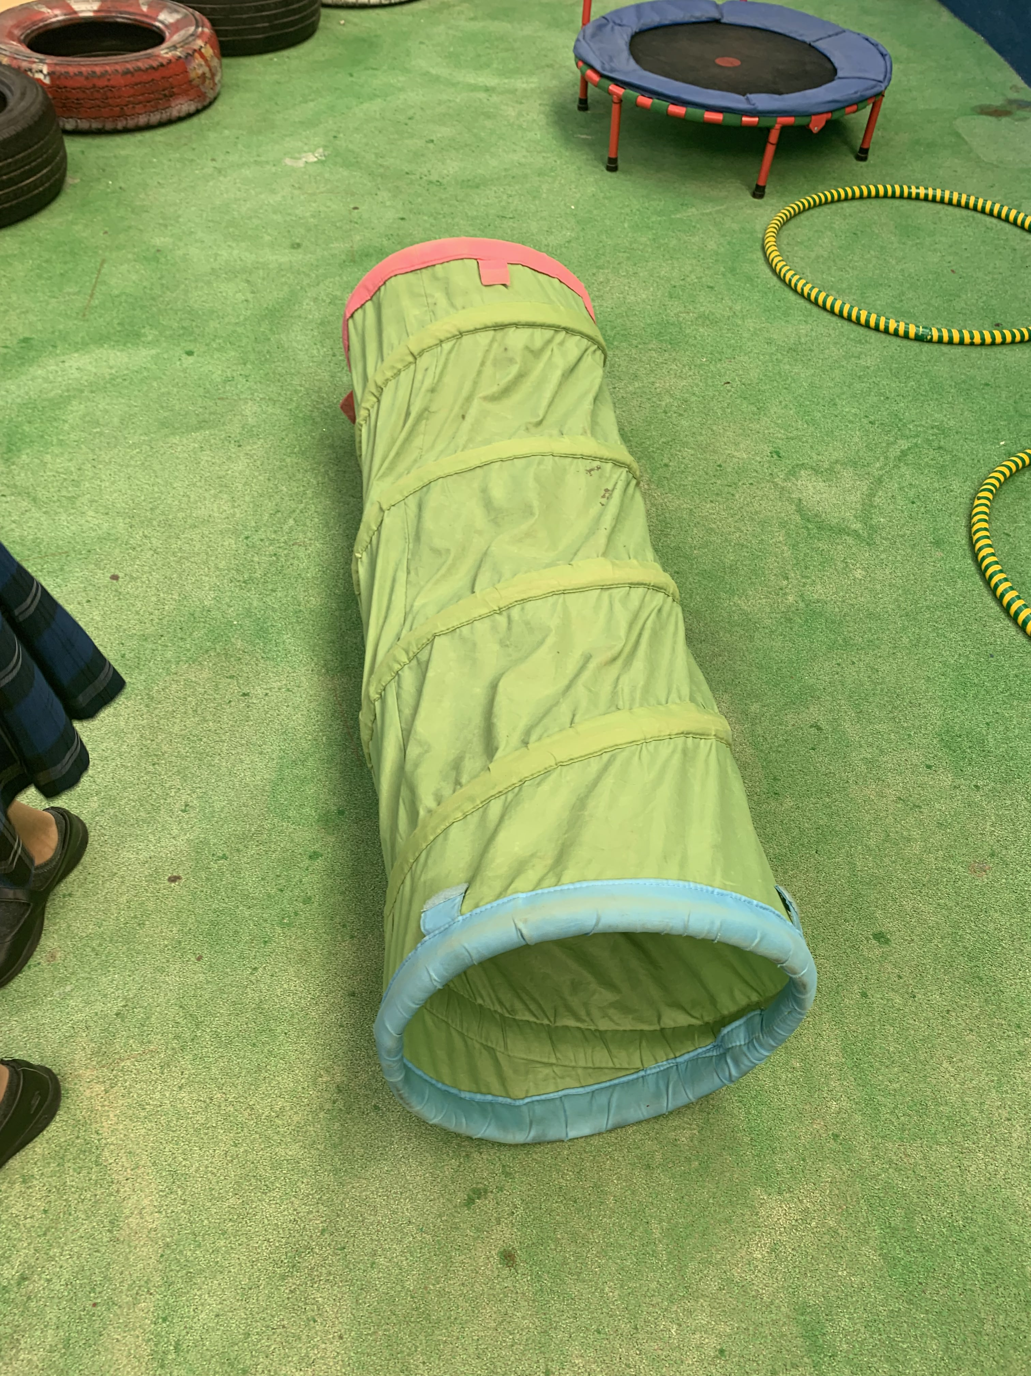
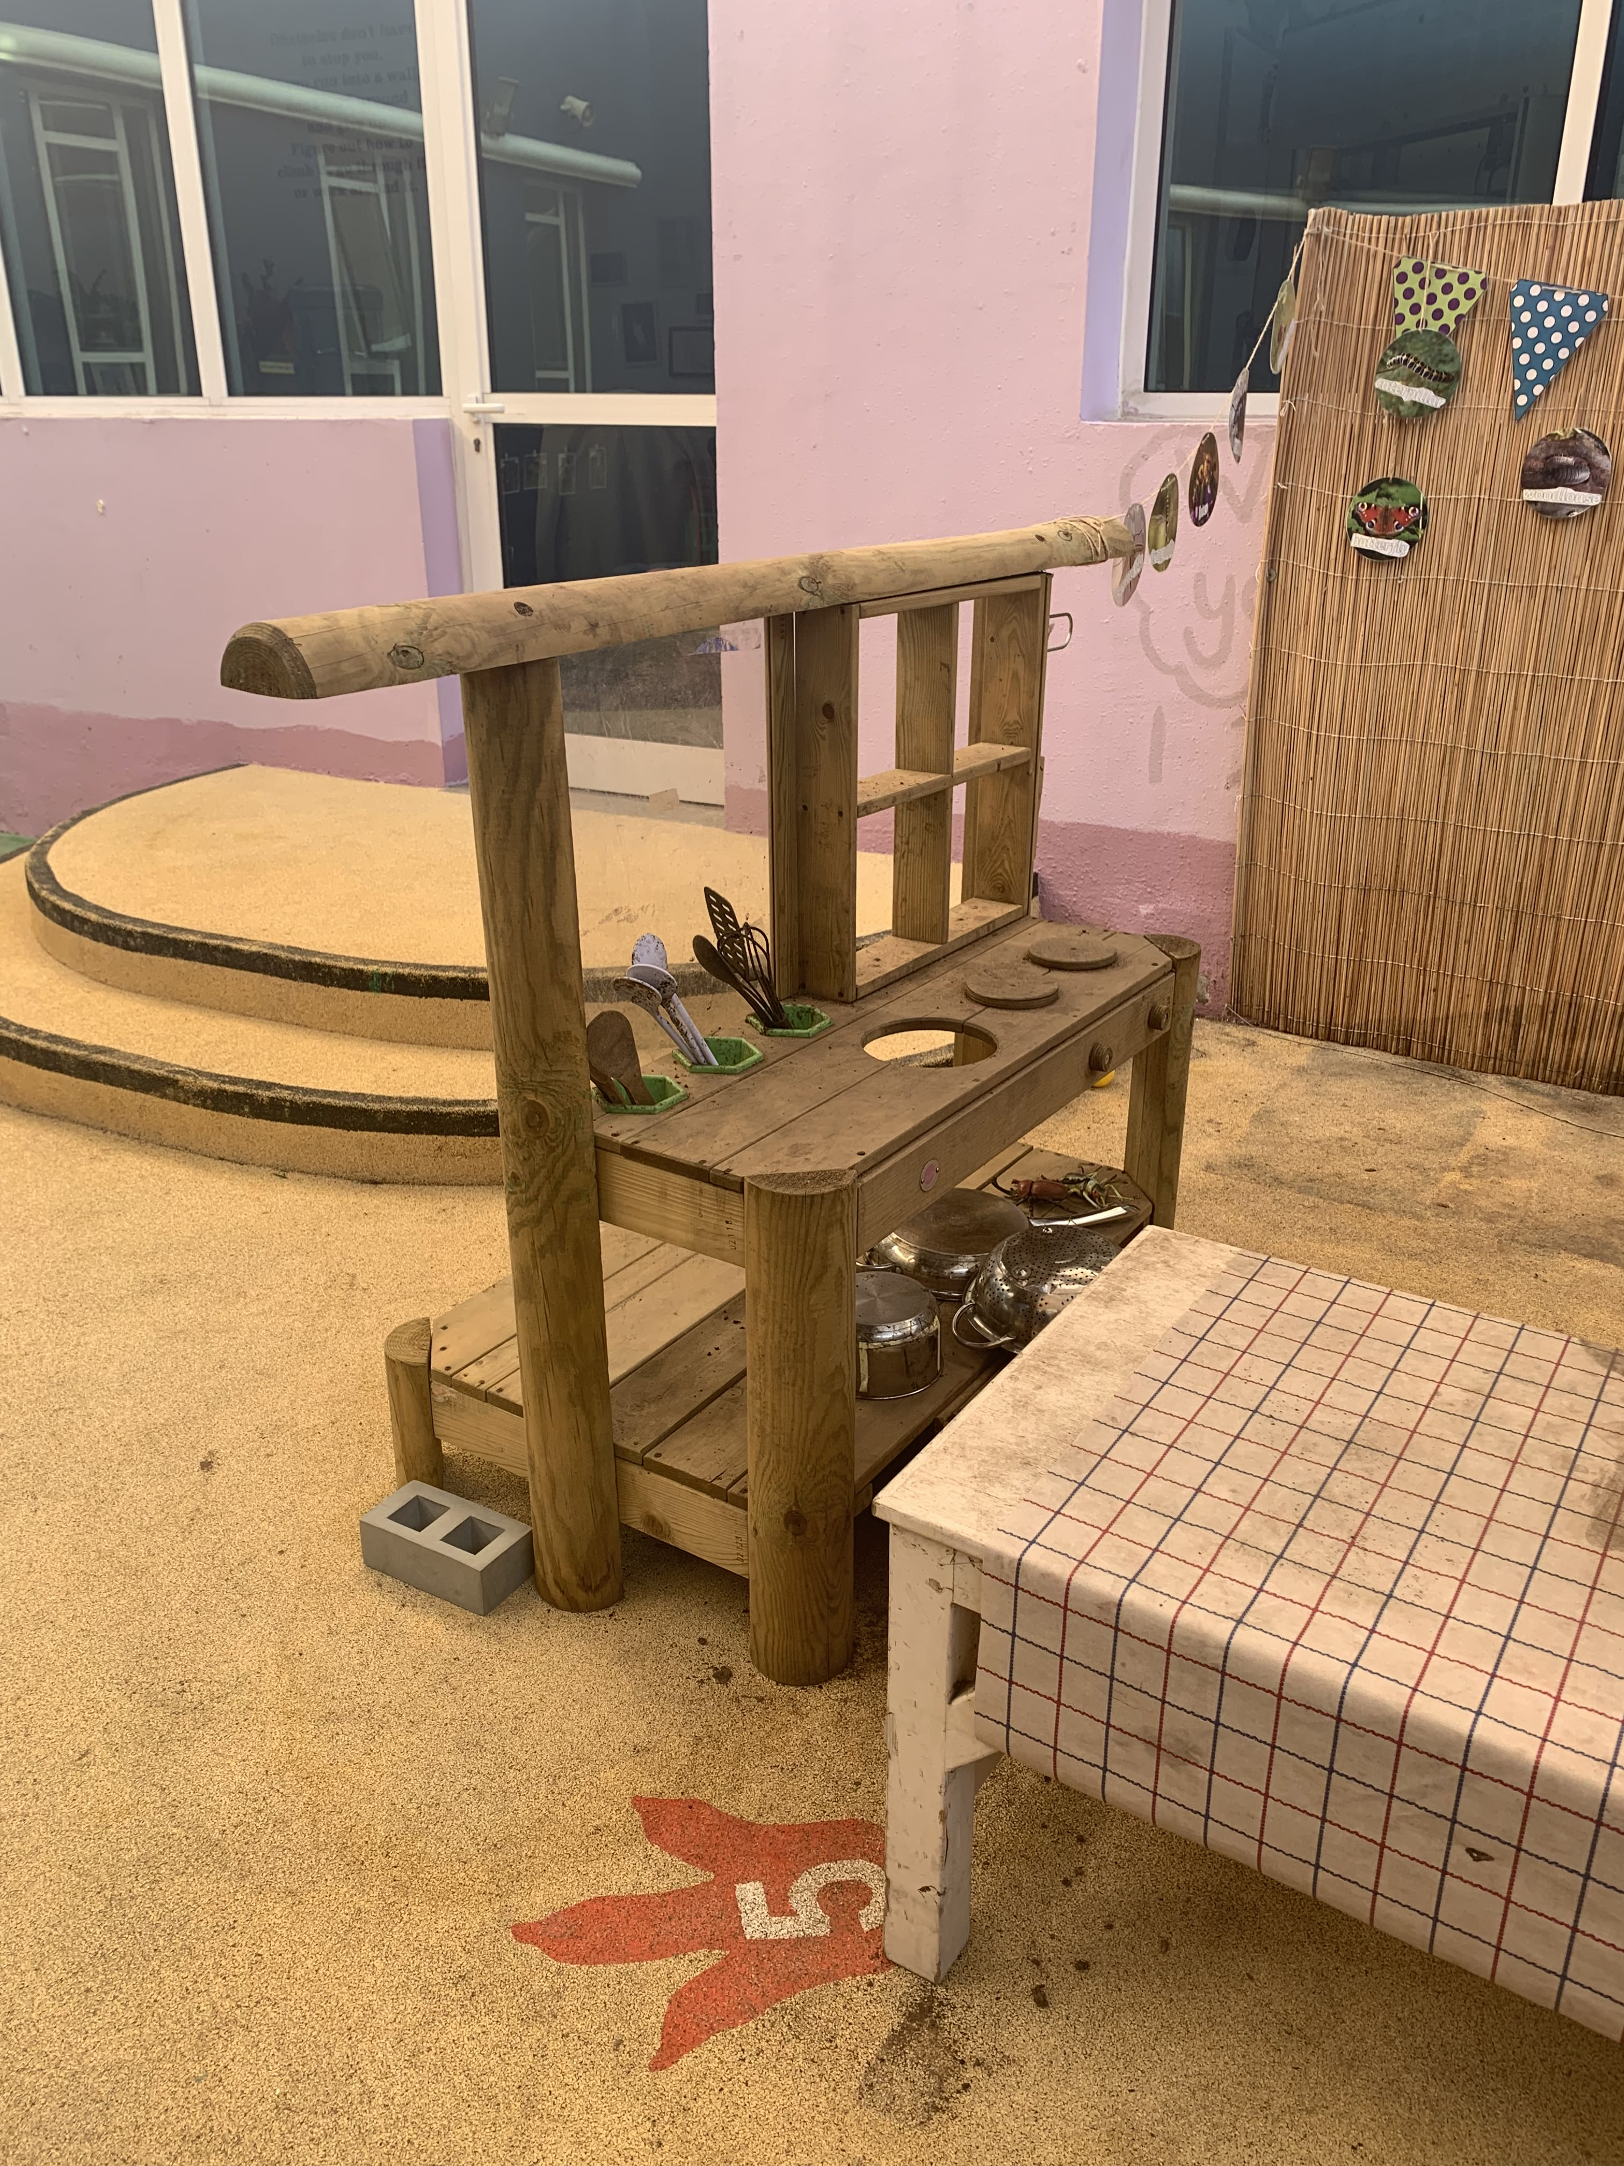
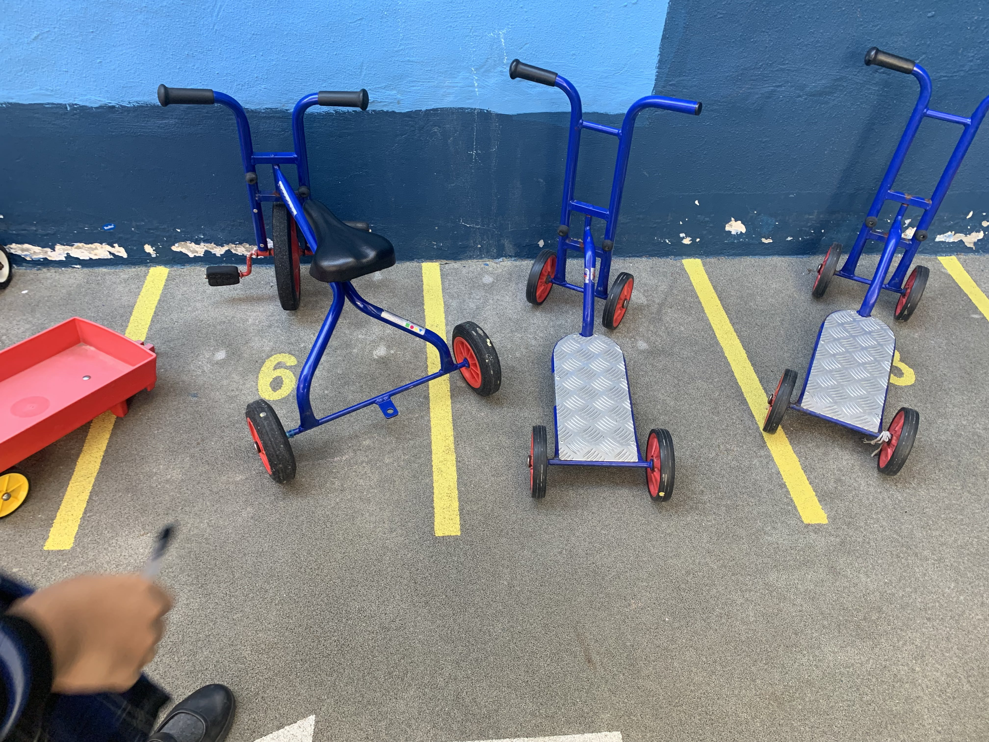
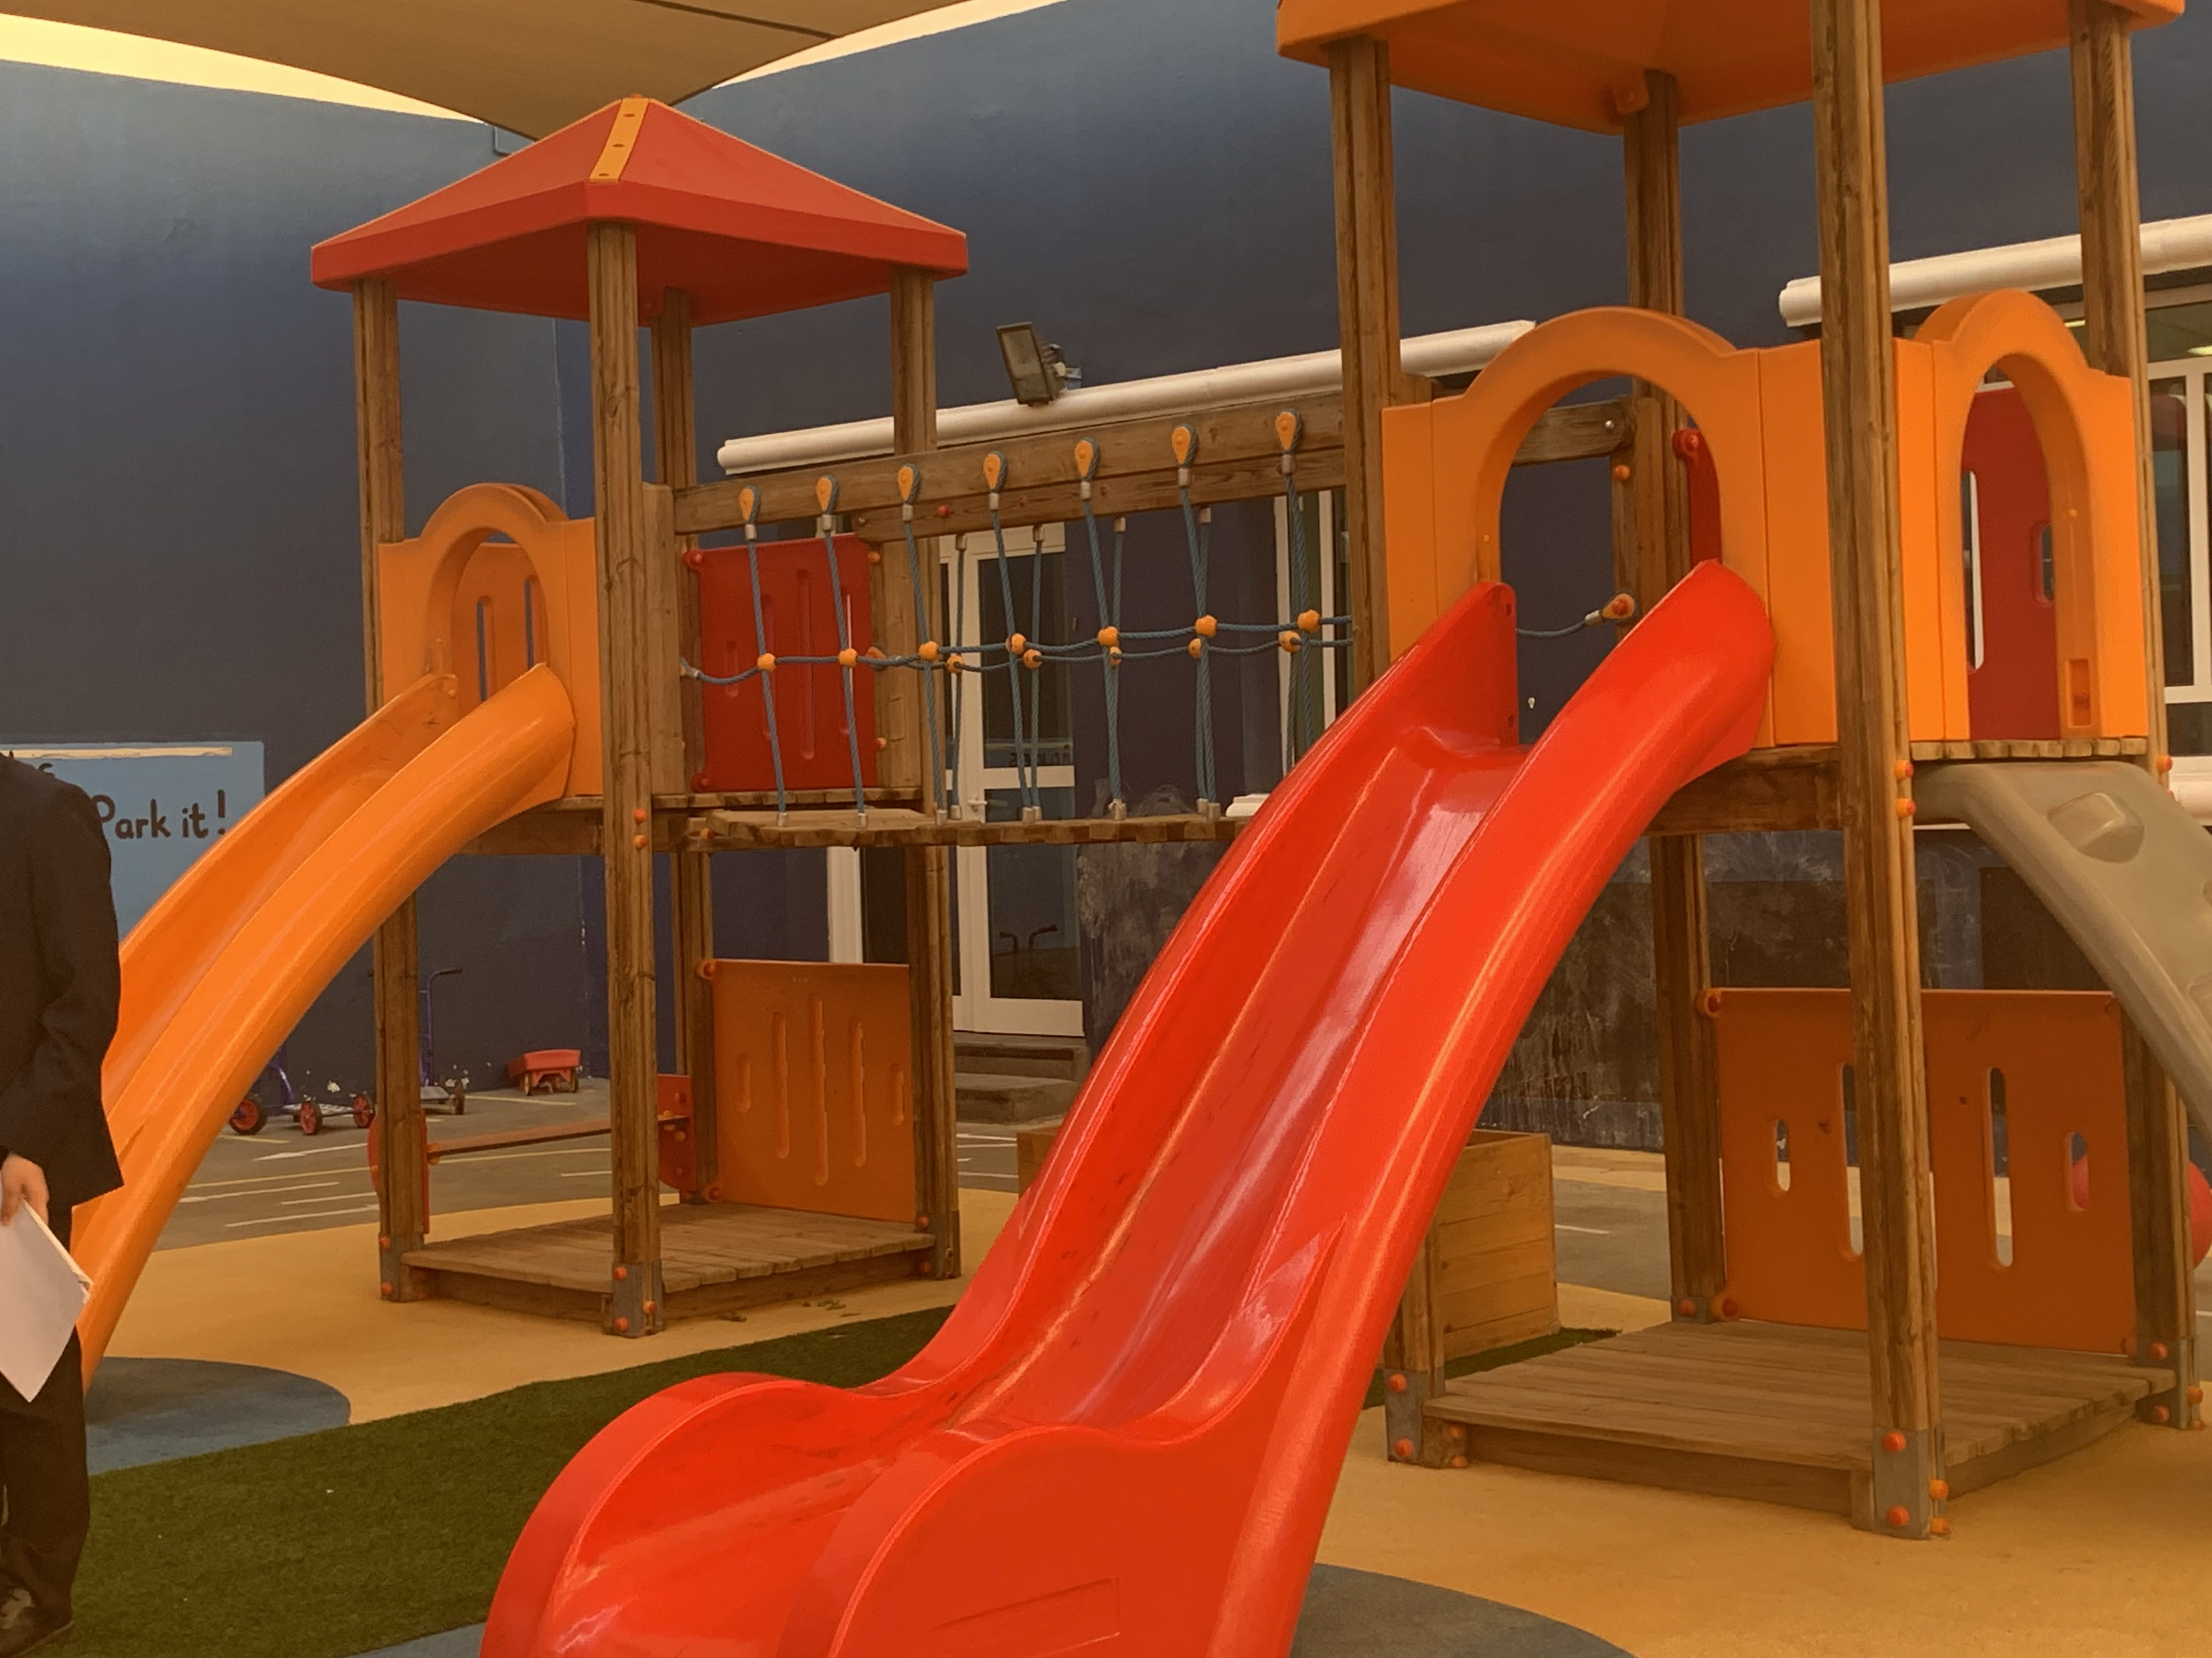
Introduction
The question I chose is:
How can products be used to make playtime in the primary school playground more interactive and fun?
I chose this question because our school has a primary school playground close to me which I can have easy access to. Therefore, I can have better understanding of what I have to consider when making the products.
Needs for the end user:
The users would be the primary school students in the age between three and five. They are not very tall so that the product should be the appropriate size for them. Also, the children are very young, so they may be frustrated when they encounter a product they don’t know how to play with. The product needs to have a very clear use and be intuitive on how they should interact with the product. They would be very weak in strength and would get hurt easily. When making the product, the product should be safe and aware of any potential dangers.
For primary research, I will investigate the primary school playgrounds and see what kind of playground equipment already exists and how it adapted to make the children’s playgrounds more interactive, fun and safe. Before I establish the problem, I will ask a few questions to the caretakers to obtain information about the kids and the playground.
Does girl and boy play together?
How and when do they get hurt?
What playground toys aren’t used very much?
What makes the perfect primary school playground? (Secondary Research)
https://www.kompan.co.uk/what-makes-the-perfect-primary-school-playground
Natural play options
Different styles of play
Meeting spaces
Purpose-built equipment and flooring
Common types of playground equipment:
Slides
Plastic tunnels
Swings
Merry-go-round
Trampoline
Tricycles/Scooters
Spring rider
Seesaw
Sand box
Climbers
Playing house
Common features of playground equipment:
They have round-edged equipment and mostly made with soft material such as wood and plastic. The bikes are three-wheeled and the scooters have four wheels to prevent the kids from losing balance and falling. The slides and climbers have smooth finishes because it is easy for kids to get hurt if it does not. The playground equipment do not have sharp or parts where it sticks out. The height of the playground is generally very low to suit the kids when they are playing.

Slide 4
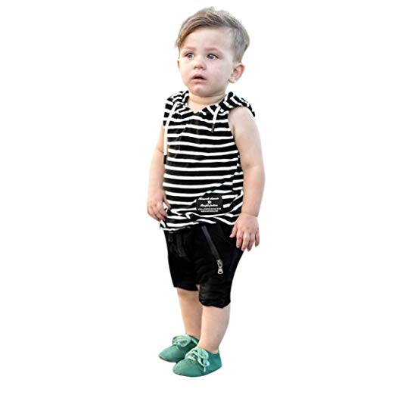
Users
The users of the product would be children between the age three and five
Location:
The children are located in Abu Dhabi, UAE
General Interests:
They would like to have some form of swing to use.
General Behaviour (The information was acquired by asking their teachers):
They all play together, if one kid goes to another station, others follow too.
The equipment IS used by both sexes
The only station that was in use was the mud pie cooking station, so they like to express creativity, although, there was no point to what they were doing, it was just mixing mud and water and pouring it onto the floor.
They play while standing
They do sometimes get hurt when they fight over a playground object, but they don’t stay salty
They like activities where they can make and break stuff, for example, they like to make creative mud things and they like smashing ice cubes with little dinosaurs inside them with hammers.
They like playing with kitchen objects
They engage with each other
They were creative and messy
Additional Description:
There were certain safety and hygienic precautions when playing with the mud pie cooking station
They had to wear and apron
The objects were blunted to be safe
After every activity they had to wash their hands
Design Requirements:
An interactive, fun and safe playground equipment designed for primary school students
Anthropometrics
The kids are between three to five years
of age. Their anthropometric
data(on the right) shows that the 95th
percentile of 5 year old males are the
heaviest. In conclusion, my product has to
withstand at least 31kg of weight.
The anthropometric data on the kids’
height is on the left. The highest(the 95th
percentile of males) value is 122.4cm
and the lowest(the 5th percentile of females)
is 90.9cm. These values are important as
when I design the product, the dimensions
would not be too long nor too short.
I want a toy that lets me to express my creativity!!

Slide 5
Users
I have found the need to add on more anthropometric data
I will be adding them on.

Slide 6
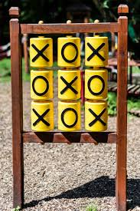
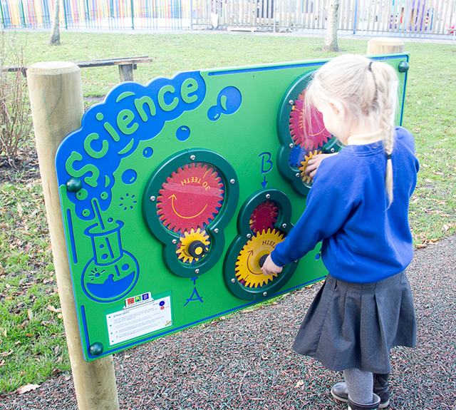
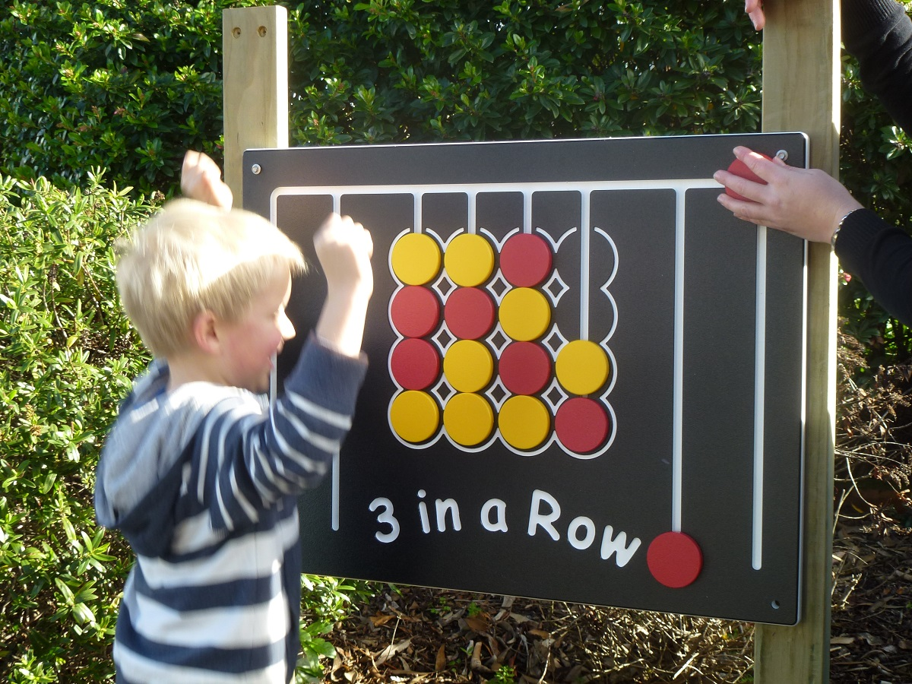
Investigation
Existing products:
1. Tic-Tac-Toe/Science/Connect-4 Panels
Aesthetics: No attributes that suggests the product to be aesthetic
Consumer: These products are limited to one or two people when playing with it. Therefore, it doesn’t satisfy our user needs for a interactive playground equipment
Environment & Sustainability: The metal bits can be reused. The product lasts long(a lifetime). The wood can be recycled or recovered as fuel/
Size: Available in different sizes. Normally a meter wide and a meter high
Safety: Most of the time it would be safe unless kids aren’t looking where they are headed and crashes. Rounded edges to protect children against bumps
Function: They can play tic-tac-toe with it.(have fun with gears or play connect-4)
Manufacture: Reasonably easy. Drill holes on the rods and attach the panel
Materials: The panel is usually made with plastic and the outer rods that fix the panel to the ground is metal or wood.
2. Mud Pie Cooking Station
The red and blue each represents disadvantages and advantages
Aesthetics: The wooden kitchen gives an appealing look to the playground
Consumer: It is interactive as many kids can play with it at once.
Environment & Sustainability: The wood bits can be recycled or recovered as fuel. The product is made with wood but the user uses water and mud to create mud pies which is not good for the sustain of the product
Size: Available in different sizes. Normally a meter wide and a meter high
Safety: It would be safe for most cases. Kids might get hurt due to the misuse of the cooking equipment such as spatulas or by accidently eating mud. Rounded edges to protect children against bumps
Function: The kids can collaboratively make mud pies
Manufacture: A bit complicated as it requires human assembly and accurate drilling
Materials: Most of it is made with wood. The cooking tool holders are made with plastic, the pot is made with metal.

Slide 7
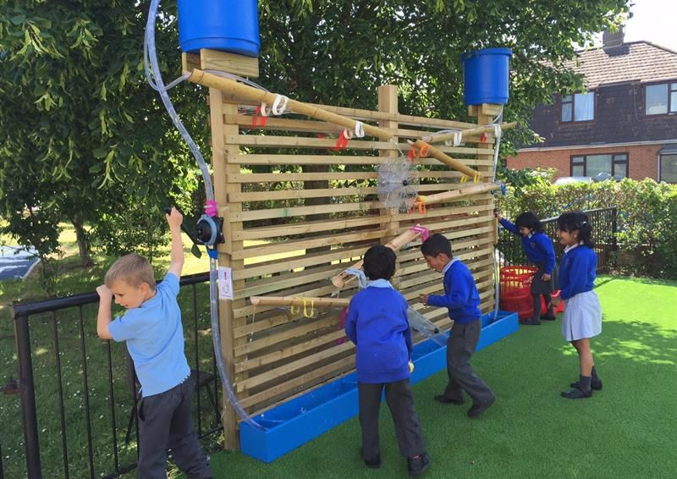
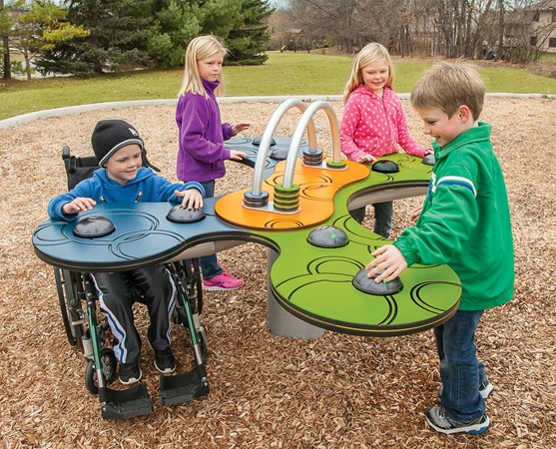
Investigation
Existing products:
3. Water Walls
Aesthetics: The wood material could provide an aesthetic and calming grain structure that can be appealing.
Consumer: It is interactive as many kids can play with it at once.
Environment & Sustainability: The wood bits can be recycled and recovered. Since the wood is close to planks it can even be reused. The wood interacting with water suggests a short lifetime for the product.
Size: Three meters wide and two and a half meters high.
Safety: The product is tall, therefore, the centre of mass is high. This can cause the product to be unstable and could fall down if not fixed correctly. No other potential safety hazards apart from this
Function: Water falls from top to low. The water way can be changed by the children. The Water that reaches the bottom goes back up through the pump.
Manufacture: This is a one of a kind product which is made through special orders or by hand.
Materials: Wood for the structure and plastic for the tubes the bucket and the connection between the structure and the water ways
4. Pulse® Table Tennis – Multisensory Interactive games – landscape structues
Aesthetics: The unique design gives an impression of a future playground
Consumer: It is interactive as many kids can play with it at once.
Environment & Sustainability: The wood bits can be recycled or recovered as fuel. The product is made with wood but the user uses water and mud to create mud pies which is not good for the sustain of the product
Size: 4.83 m x 4.34 m
Safety: A kid could attempt to go under then stand up and bump his or her head. It has round edges to protect the kids when bumping into them.
Function: Can play table tennis by just touching the sensors.
Manufacture: Made in the factories
Materials: Metal for the pillar in the middle. Chipboard for the board on the top with extra electrical components

Slide 8
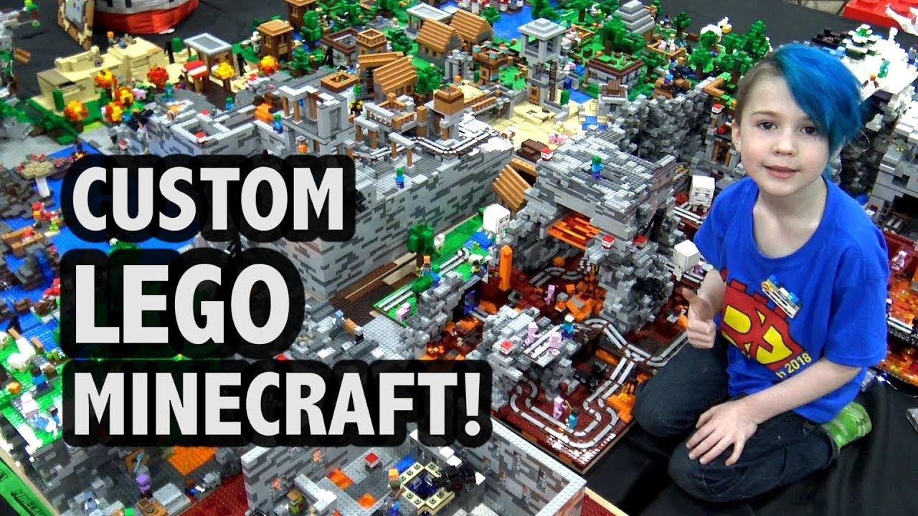
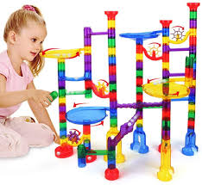
Investigation
Ideas that I can use:
1. Legos
Aesthetics: Colourful.(The shape depends on the user)
Consumer: Unlimited amount of kids can play with it.
Environment & Sustainability: The plastic is a thermoplastic material, which makes it easily recyclable. No need to throw a way the product as it is reusable(can be given away) The pieces don’t last long as they can be easily damaged
Size: Available in different sizes. (depends on the user)
Safety: Can get hurt if they fall on the pieces. It is dangerous if eaten.
Function: You connect blocks to make anything you desire to. Can express creativity
Manufacture: Automated manufacture in factories
Materials: Plastic called acrylonitrile butadiene styrene
2. Marble runs
The red and blue each represents
disadvantages and advantages
Aesthetics: It is colourful. The interesting shape of the marble tracks may be pleasing for some people
Consumer: It seems hard for many kids to play with it at once.
Environment & Sustainability: : The plastic is a thermoplastic material, which makes it easily recyclable. The pieces don’t last long as they can be easily damaged
Size: (Depends on the user)
Safety: It would be safe for most cases. Can get hurt if they fall on it
Function: The user can make tracks for the marble to run down.
Manufacture: Automated manufacture in factories
Materials: Varies from plastic to wood

Slide 9
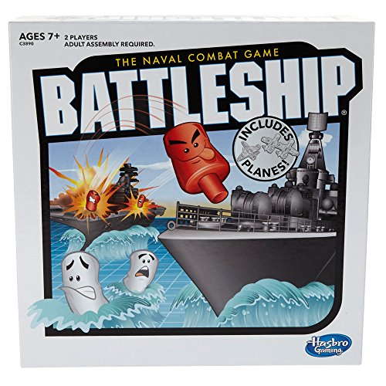
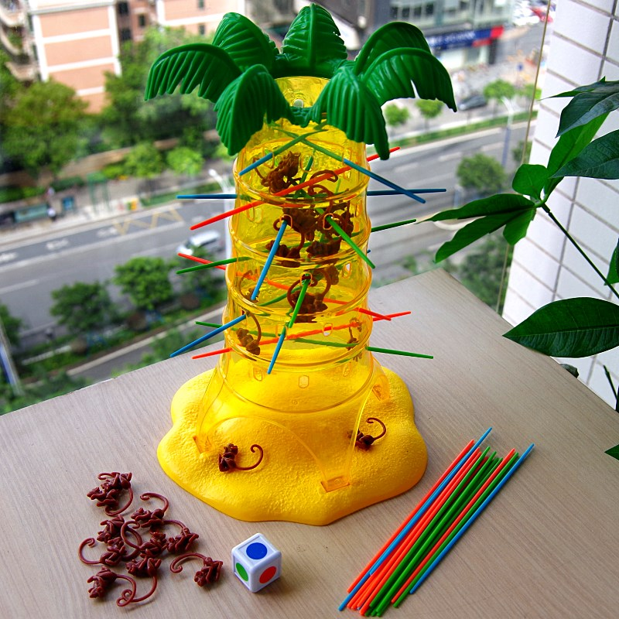
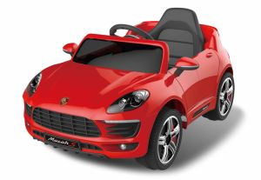
Investigation
Ideas that I can use:
3. Boardgames
Aesthetics: It has simple designs
Consumer: The amount of players per game differs but normally 2 to 6.
Environment & Sustainability: Can be continuously used or sold in a garage sale
Size: Available in different sizes. Normally smaller then 50cm x 50cm x 50cm
Safety: Most of the time it would be safe. Could eat one of the small pieces.
Function: Can play a game under the certain rules.
Manufacture: Made in factories
Materials: Wood, plastic, metal.
4. Electric car toys
The red and blue each represents disadvantages and advantages
Aesthetics: The car design is very appealing
Consumer: Only for one kid
Environment & Sustainability: Batteries inside the toy car may cause pollution
Size: Mostly in the dimension of 70cm x 50cm x 50cm
Safety: Can get hurt when going too fast. Can bump into a nearby person.
Function: The driving kid can drive the car.
Manufacture: Factories produce the pieces and humans are involved in the assembly process.
Materials: Metal for the mechanics, plastic for the exterior. Rubber for the tires.

Slide 10
Design Brief & Specification
I am designing a playground equipment for children at the age of three to five years old that is interactive, enjoyable and allow the children to express their creativity. It should also be safe and easy to use.
The prototype will then be assessed based on these specifications. Each specification is awarded a certain value depending on its importance: must (+3), should (+2), and could (+1). By adding up the points, we can see if the prototype is successful or not
Specification Area | Specification Point | Explantation
Form(A) – (Total points: 1) | A1. The product could be decorated to have aesthetic features such as colours patterns. | A1. Can intrigue the kids’ creativity.
Function(B) – (Total points: 8) | B1. The product must not be boring to play with. B2. The product must be interactive B3. The product should be able to be used by multiple kids. | B3. Kids like playing together
User Requirements(C) – (Total points: 8) | C1. The product should be intuitive in how to use it. C2. It must be adequate for the kids within the height of 90.9 cm and 122.4 cm. C3. It must be gender-neutral. | C1. Its good if the kids are able to understand how to play with it the moment they see the product. C2. The range of height is 90.9 cm to 122.4cm. C3. They play together regard-less of gender. The playground equipment shouldn’t create the gender boundaries for them.
Performance Requirements(D) – (Total points: 9) | D1. It must withstand at least 31kg of weight D2. The product must be stable D3. The product must be resistant | D1. The 95th percentile of 5 year old males were the heaviest of 31 kg. D2. So that it doesn’t fall on a kid. D3. The product should be resistant to kids trying to break it as they like to do so.
Material & Component Requirements(E) – (Total points: 11) | E1. Materials should be available in the workshop E2. Product must be made mostly of wood E3. It should be easy to clean. E4. It should be water-resistant E5. Other materials such as acrylic and nylon should be used in small quantities. | E3. The kids like to be messy. Also, to easily remove the sand on the equipment. E4. Playground equipment are placed outside. They should be water-resistant to last longer E5. Though acrylic is thermoforming, it is still better to limit the use of plastic as it requires crude oil, which is a finite resource whose processing requires a lot of energy.
Sustainability(F) – (Total points: 4) | F1. During production, as little waste possible should be produced. Materials should be accurately calculated. F2.Materials used should be recyclable | F1. Producing less waste is beneficial economically and environmentally F2. The product needs to have a good Life-cycle assessment(LCA)
Safety Precautions(G) – (Total points: 6) | G1. It must not have sharp edges or any dangerous features G2. The wood must not be toxic to kids. | G2. Some woods contain microscopic-fibre or dust that can potentially harm the kid throughout the course of use.
Assessment Criteria: As previously considered, one way of assessing the criteria will be through the specification score. This is worth a total of 47 points. However, I will also interview 10 people and ask them to rate the product – from a purely aesthetic appeal –out of 10 and its manoeuvrability out of 10. The mean will then be calculated. Thus, the final rating will be out of 67, with the interview being worth 30% of the marks, and the specification, 70%.

Slide 11
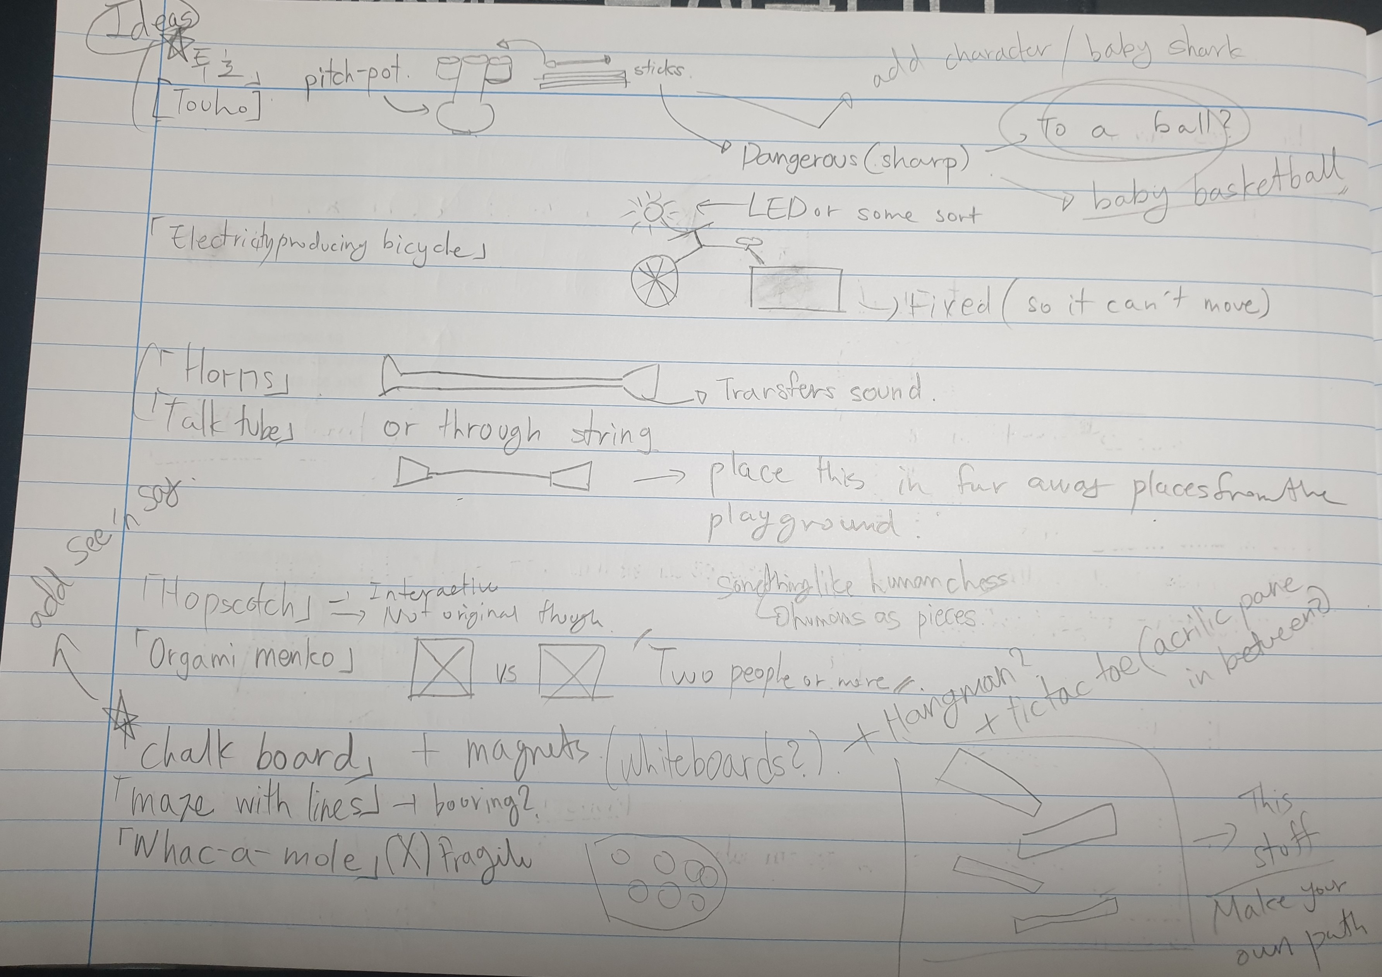
List of ideas (Brainstorming of ideas)

Slide 12
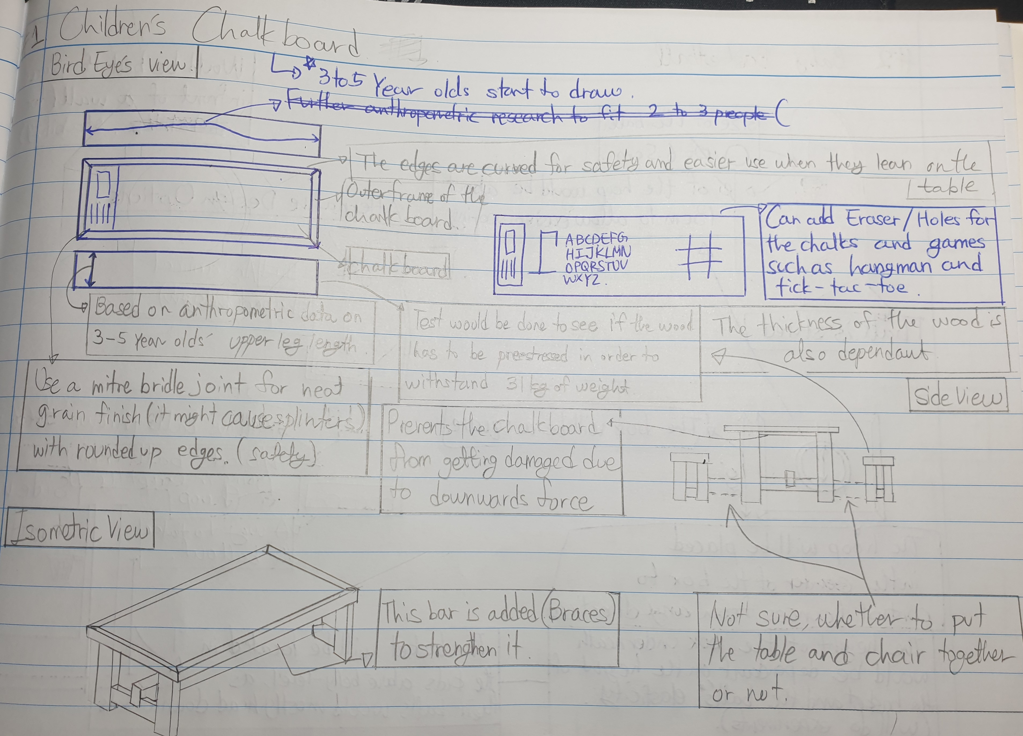
Initial ideas (Children’s Chalkboard)

Slide 13
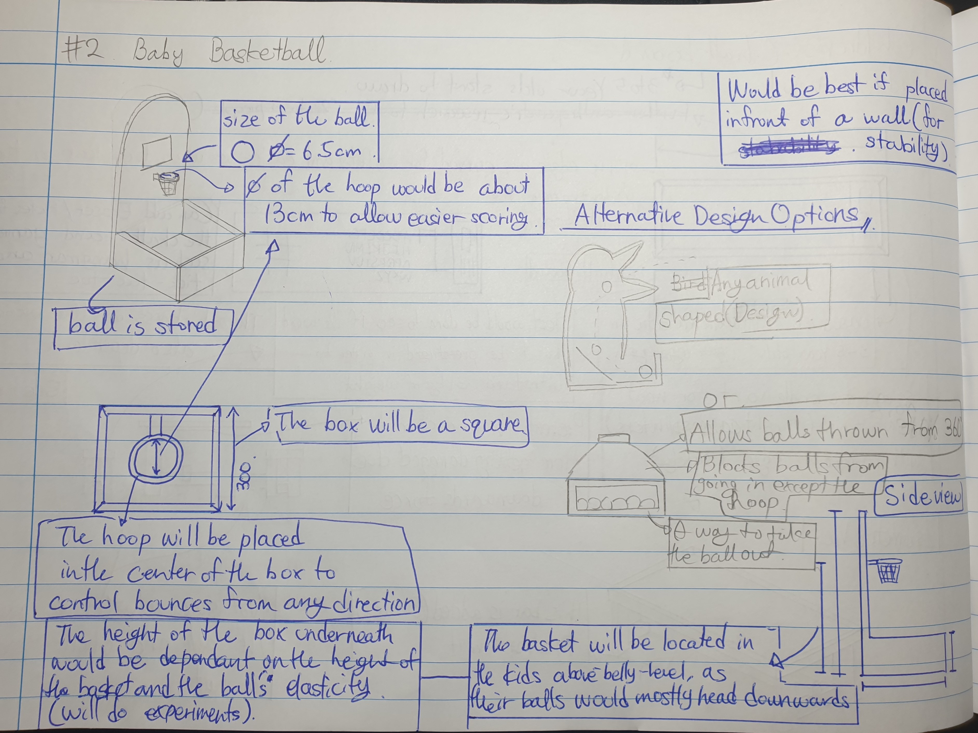
Initial Ideas (Baby Basketball)

Slide 14
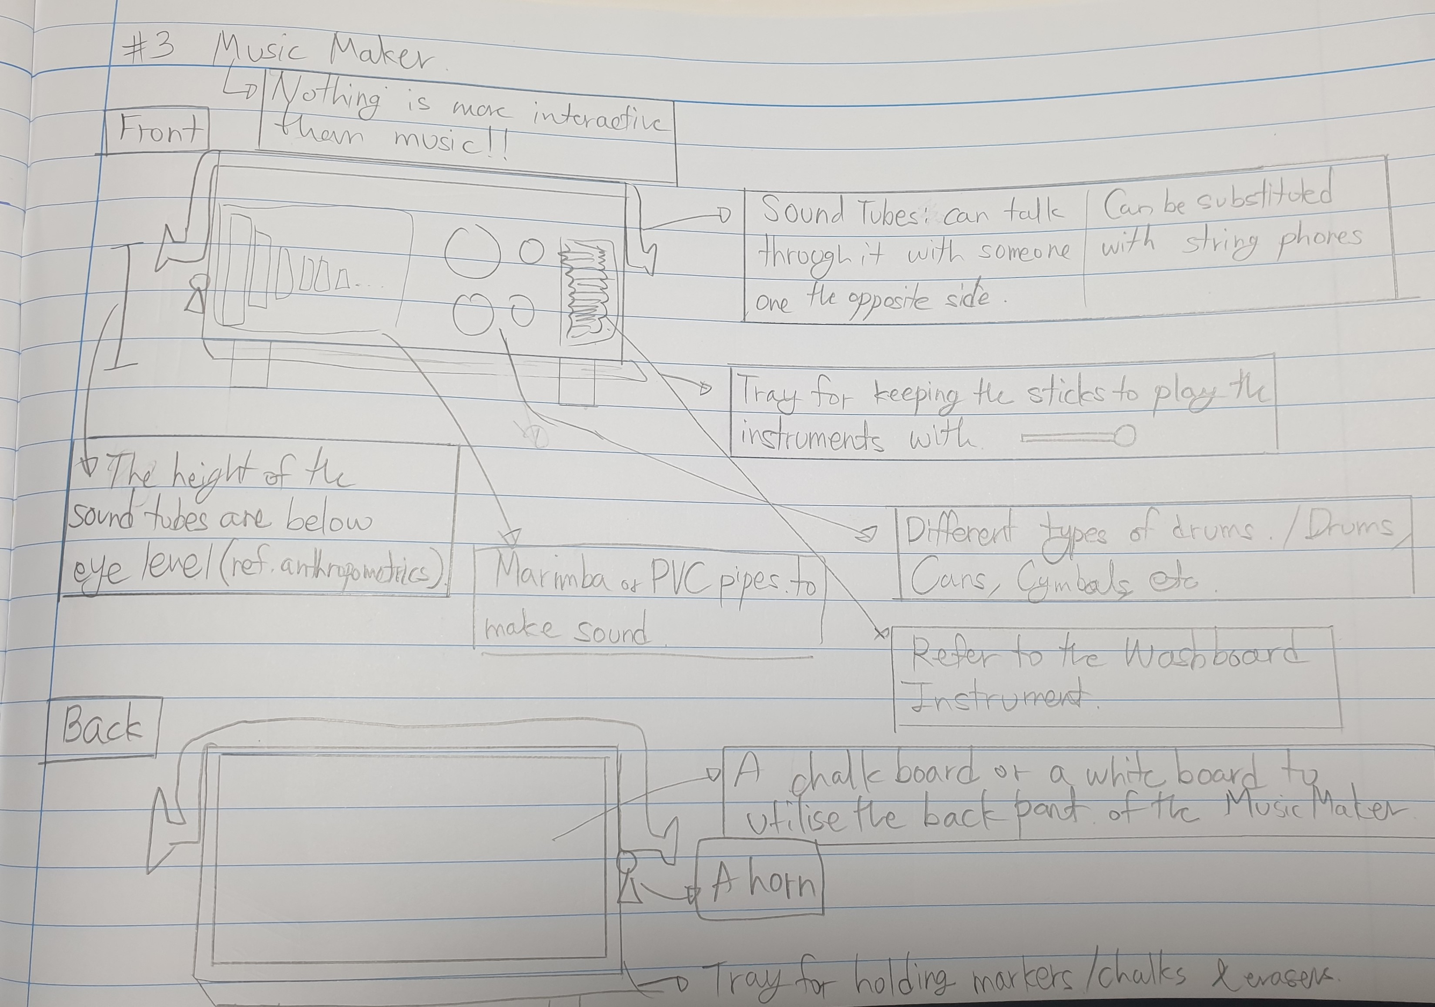
Initial Ideas (Music Maker)

